Slide 1
FreshGuard IOT :Smart Food Storage Monitoring
Protecting Inventory Freshness Through Real-Time Environmental Intelligence

Slide 2
Executive Summary
The Vision: To transform traditional food warehouse monitoring into a proactive, data-driven system that ensures maximum product safety and minimal waste.
The problem: Food can spoil very easily if the temperature or humidity changes. Since people aren't always there to check on it, mistakes happen, which leads to wasted food and problems with safety rules.
​Our Solution: A robust IoT Environmental Data Logger that provides 24/7 real-time visibility into temperature, humidity, and critical storage conditions.

Slide 3
The Challenge (The risks to food quality)
Unstable environment
Manual check missed
Food begins to spoil
Financial and Compliance loss

Slide 4
Our Solution (Introduction to the Data Logger)
Proactive Digital Guard:
An IoT-based monitoring system specifically designed for food storage environments
High-Precision Technology:
Uses advanced sensors to track vital conditions like temperature and humidity with extreme accuracy.
​Built for Durability:
Engineered to withstand tough cold storage settings, ensuring reliable operation 24/7.

Slide 5
Key features:
Precise monitoring
​Uses high-quality sensors to track temperature and humidity with extreme accuracy.
Cloud connectivity
Automatically syncs data to the cloud for 24/7 remote access.
Smart alerts
Sends instant notifications if conditions ever go outside of safe limits.
​Keeps a constant watch on conditions to ensure food stays fresh.
​Easily plugs into your existing warehouse system without any complex setup.
​Helps staff stop spoilage before it happens by acting fast.

Slide 6
Hardware & Technology stack
User feedback & infrastructure
OLED display & buzzer
Core controller & Connectivity
ESP32
Evironmental Sensing siute
DHT22 sensor
LDR & resistor
MQ-2 sensor

Slide 7
Working principle
ESP32 reads data from all sensors every few seconds
Sensors readings are displayed on an OLED display
Data is transmitted over WIFI
Sensor values are uploaded to an IOT cloud platform
Historical data is restored
If any parameter exceeds its threshold:
BUZZER activates
Alert notification

Slide 8
Green(safe):optimal storage conditions. Yellow(warning): preventive action needed. Red(danger):critical threshold breach.
Digital Dashboard
Centralized Monitoring: Real-time visibility into all warehouse zones from a single interface.
Intelligent Status Logic: Uses a 3-tier LED visual system to represent environmental health:
Data Analytics: Integrated graphs for historical temperature/humidity tracking.
Instant Alerts: Automated notification system for rapid response to critical safety risks.

Slide 9
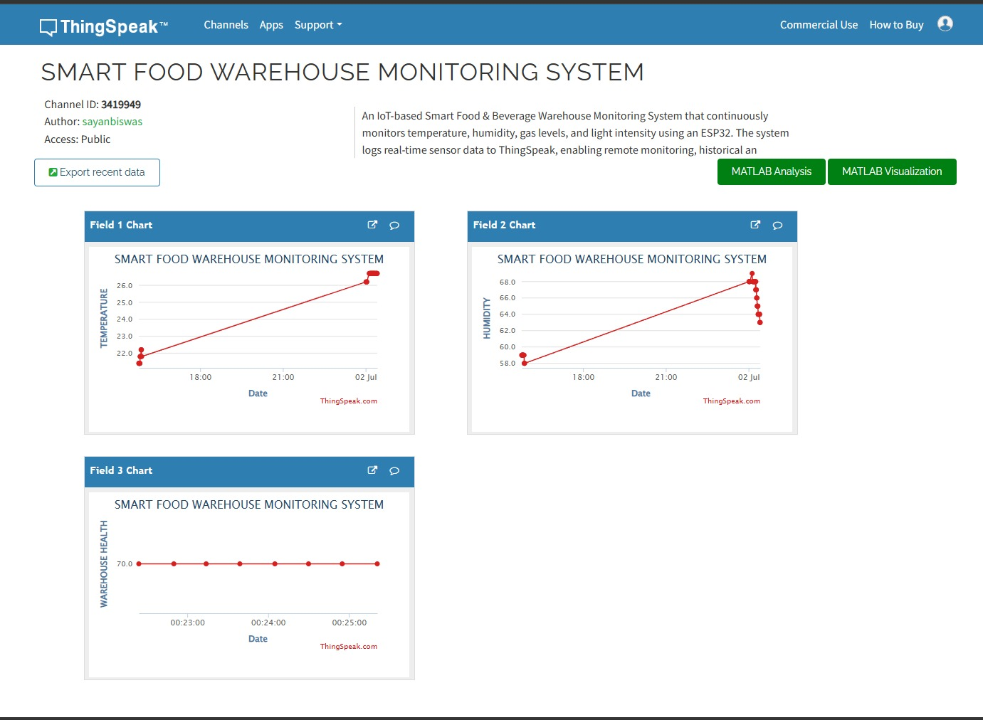
Real –time data Insights
☑ Tamper proof: every sensor reading is timestamped and stored
​☑Multi-Parameter Tracking: The system simultaneously monitors key factors including temperature and humidity to ensure optimal storage conditions.

Slide 10
Operational ROI(Cost saving & Efficiency)
Waste Reduction
Labor Efficiency
Lower insurance cost
Faster audits
Energy Optimization

Slide 11
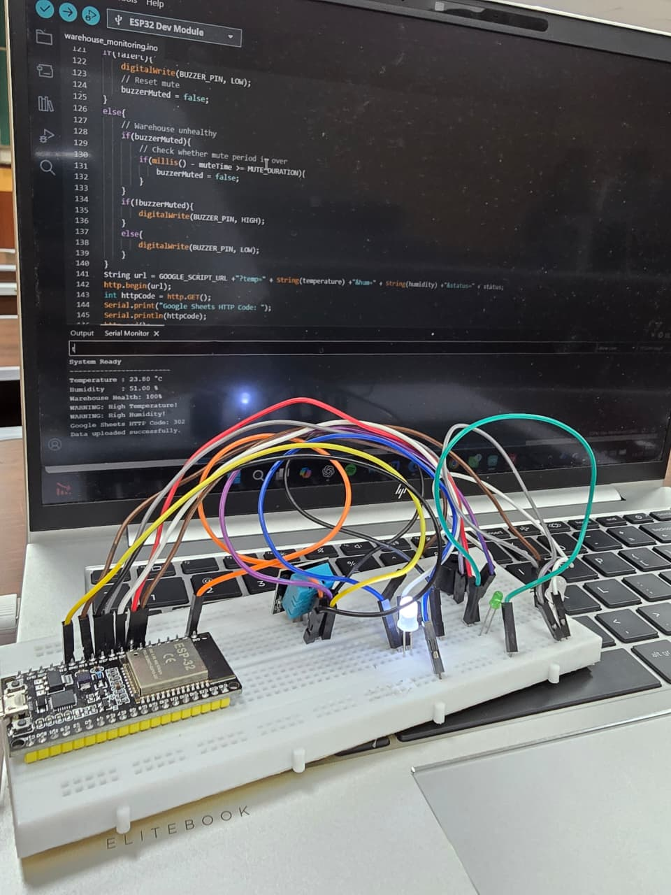

Slide 12
Dashboard link
https://www.loom.com/share/eef106b6f0a1437fbeaee7eebba432a6

Slide 13
THANK YOU
Any questions or feedback?

